Slide 1
China Trade Effects Domestic Policy:
How political behavior in congress is expressed via Twitter

Slide 2

Thesis:
Does Chinese Economic penetration affect the way in which congress people frame their public positions toward China?

Slide 3
Research Process
Research
Research Congressional Districts where there are high levels of Chinese economic penetration.
Find
Find The Twitter handles for these representatives Ex: @nancypelosi
Find
Find key words where the congress people use “China”
Compare
Compare to other congress people, by party line.

Slide 4
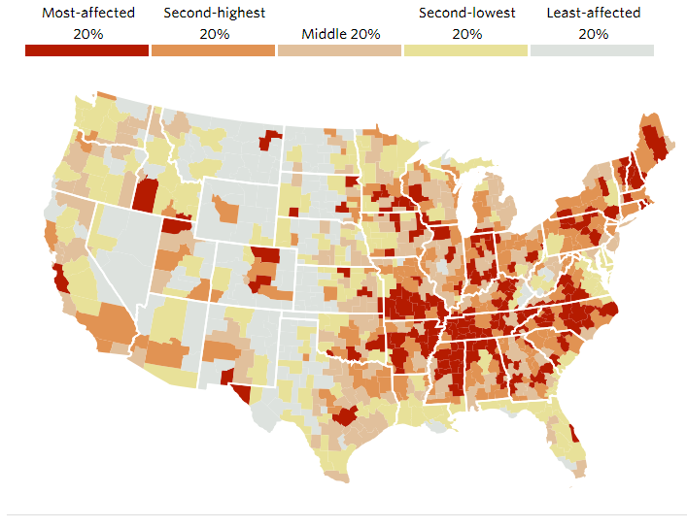
Chinese Econ Penetration
In areas where we see high levels of Chinese economic trade, we see congress people speaking about china
One of the effects, of high levels of economic activity is high unemployment.
This causes pressure for the local economy, therefore congress people talk bad about China.
Easy to blame for problems.

Slide 5
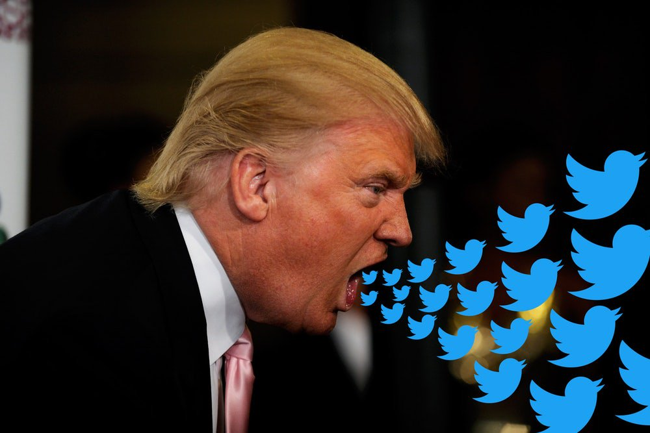
Why is Twitter important?
Global platform, hundreds of millions of possible viewers.
No one watches TV anymore.
Best way for a politician to get their ideas out into the ether.
Framing the argument in their favor “Framing/Priming”

Slide 6
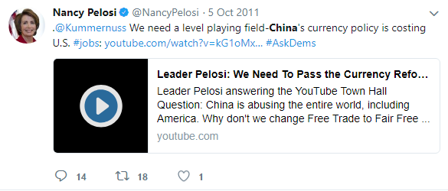
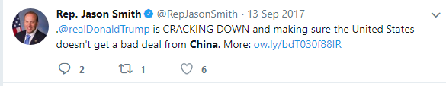
Example Tweets :

Slide 7
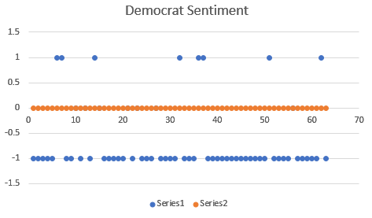
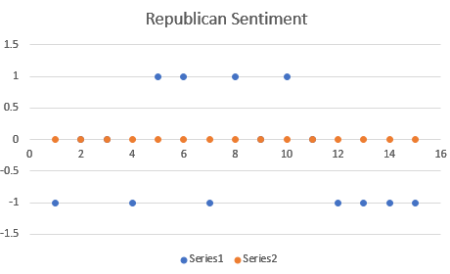
Sentiment Analysis
3 Democrats observed
3 Republicans observed
Democrats tend to be more negative by a factor of 7:1
Republicans tend to be negative by a factor of 2:1

Slide 8
Shortcomings
Only used analysis of 6 Congressional people.
There are ~50 congressional Districts in California
Software in its current state makes mistakes and classifies incorrectly.

